Slide 1

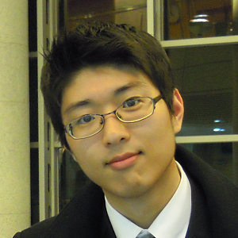
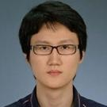
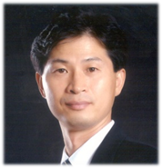
Deep Multi-scale Convolutional Neural Network for Dynamic Scene Deblurring
Seungjun Nah Tae Hyun Kim and Kyoung Mu Lee
Computer Vision Lab.
Dept. of ECE, ASRI, Seoul National University, Korea
http://cv.snu.ac.kr
Notes:
Good morning.
I’m Seungjun Nah from Seoul National University,
I’ll talk about Deep Multi-scale Convolutional Neural Network for Dynamic Scene Deblurring.
This work has been done with my colleague Tae Hyun Kim and my advisor Kyoung Mu Lee.
(15s)

Slide 2
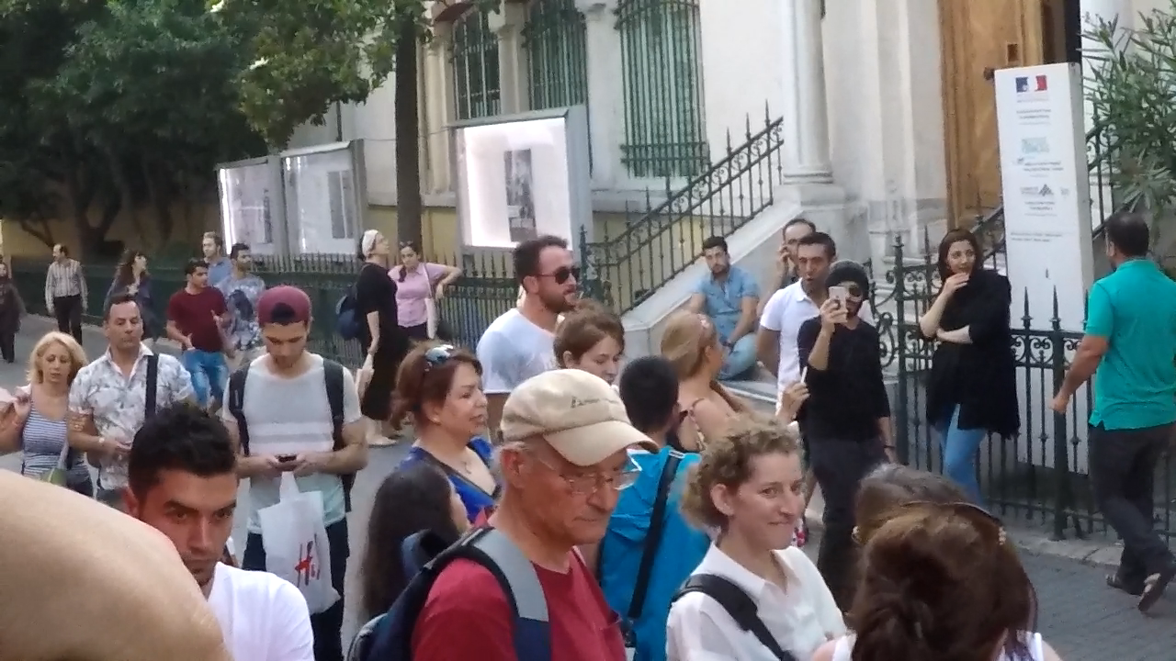

Introduction: Dynamic Scene Deblurring
Locally varying blurs from various sources
Moving objects, depth variation, camera shake, …
Notes:
Images captured in dynamic environments easily get blurred due to various sources including moving objects, depth variation, and camera shakes.
(click)
We aim to recover sharp scene from a blurry image.

Slide 3
Conventional Deblurring Methods
Energy Optimization-based methods
Joint optimization of blur kernel & latent image
Kim et al., “Dynamic Scene Deblurring,” ICCV 2013
Kim and Lee, “Segmentation-Free Dynamic Scene Deblurring,” CVPR 2014
Inaccurate blur kernel causes artifacts in latent image
Deep Learning-based methods
Uniform blur deconvolution
Xu et al., “Deep Convolutional Neural Network for Image Deconvolution,” NIPS 2014
Local blur kernel classification
Sun et al., “Learning a Convolutional Neural Network for Non-uniform Motion Blur Removal,” CVPR 2015
Restrictive assumptions on blur kernels
Notes:
Conventionally, in the energy optimization based approaches, blur kernel and latent image is jointly estimated.
Thus, kernel error propagates to image artifacts.
On the other hand, deep learning methods focused on either image or kernel estimation.
However, they had restrictive assumptions on blur kernels.
(20s)

Slide 4
Issues in Image Deblurring
Issue 1.
Cannot acquire GT sharp images and blurry images at the same time.
Our approach
Synthesize realistic data using high-speed cameras
Issue 2.
Cannot acquire GT local blur kernels for every image
Our approach
End-to-end learning of sharp image directly without estimating kernels
Issue 3.
Deblurring requires larger receptive filed
Our approach
Use multi-scale (hierarchical) CNN structure
Notes:
In this research, we focused on 3 issues in deblurring.
First, since there were no ground truth for blurs, we synthesized realistic dataset using high-speed camera.
Second, we directly estimated sharp images to avoid artifacts from kernel error.
Third, we constructed multi-scale models to handle large receptive field.
(25s)

Slide 5
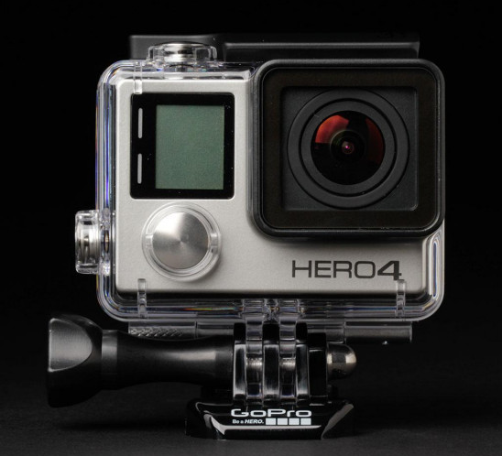


Blur Dataset Generation
Followed camera imaging pipeline using high-speed camera
Sensor signal accumulation
Camera response
Exposure
Image
Light
Sensor
CRF g
$$g\left(x\right)=x^{1/γ}$$
Used GoPro4 Hero Black camera
240 fps video
Blurry images are generated by averaging varying number (7-13) of frames
$$B=g\left(\frac{1}{T}\int_{t=0}^{T}{S\left(t\right)} dt\right)≅g\left(\frac{1}{M}\sum_{i=0}^{M}{S[i]}\right)$$
Notes:
In generating our dataset, we followed camera imaging pipeline to approximate real blurs.
We captured sharp video frames and averaged them to simulate realistic blurry images.
(15s)

Slide 6
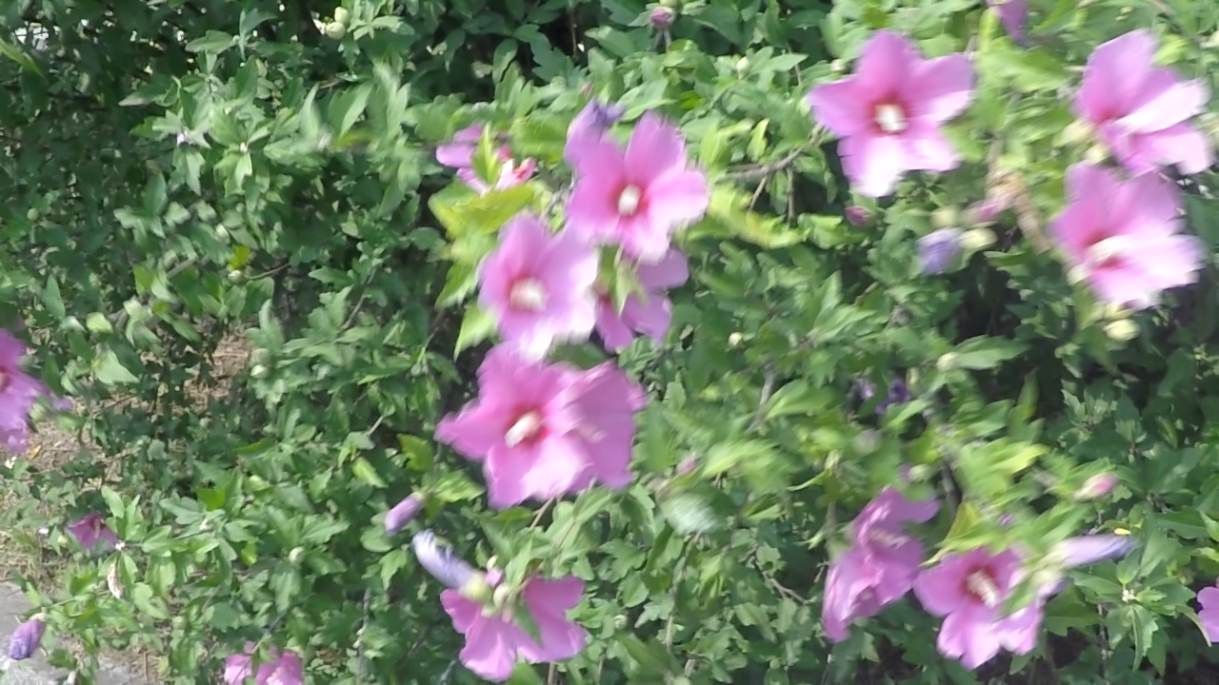
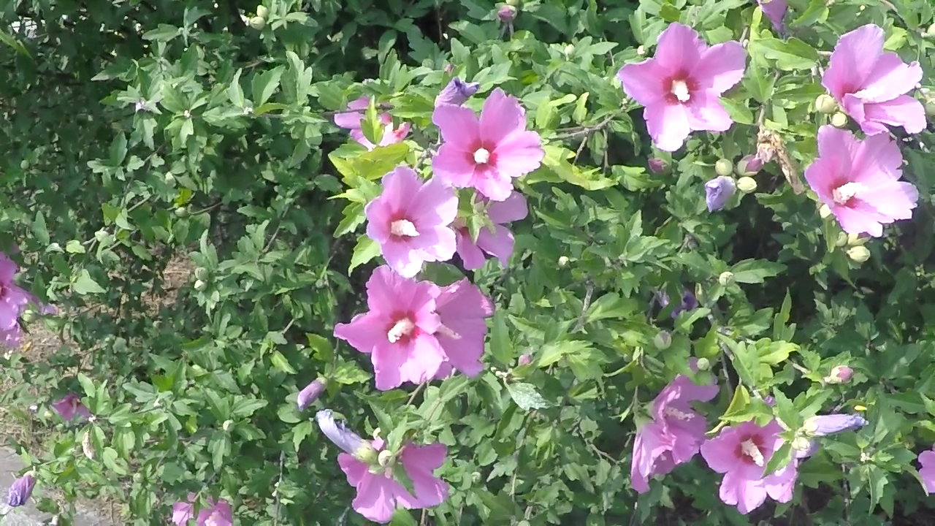




Blur Dataset Generation
Averaging
Blurry image (averaged)
Middle frame
High-speed video frames
3214 pairs of sharp and blurry images are acquired
2013 pairs for training
1111 pairs for test
Sharp image (middle frame)
Notes:
To visualize, a sequence of sharp frames in the left is averaged to be a blurry image.
As a ground truth, we chose the middle frame among the averaged.
We generated about 2000 image pairs for training, and 1000 pairs for test.
(18s)

Slide 7
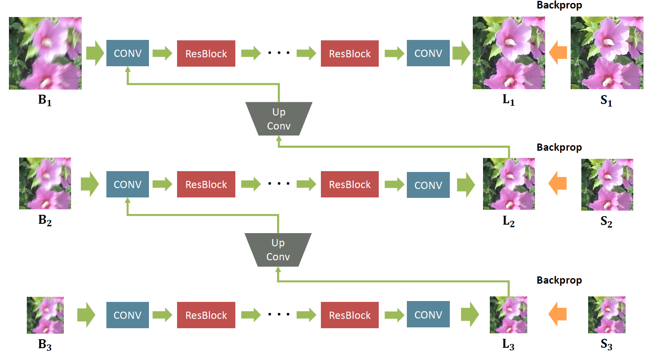
Our Multi-scale CNN Architecture
Notes:
With the proposed dataset, we trained a CNN model that estimates sharp image without kernel estimation.
To handle large receptive field, we built a multi-scale architecture that resembles conventional coarse-to-fine approach.
The fine scale image recovery is aided by coarse scale results.
(20s)

Slide 8
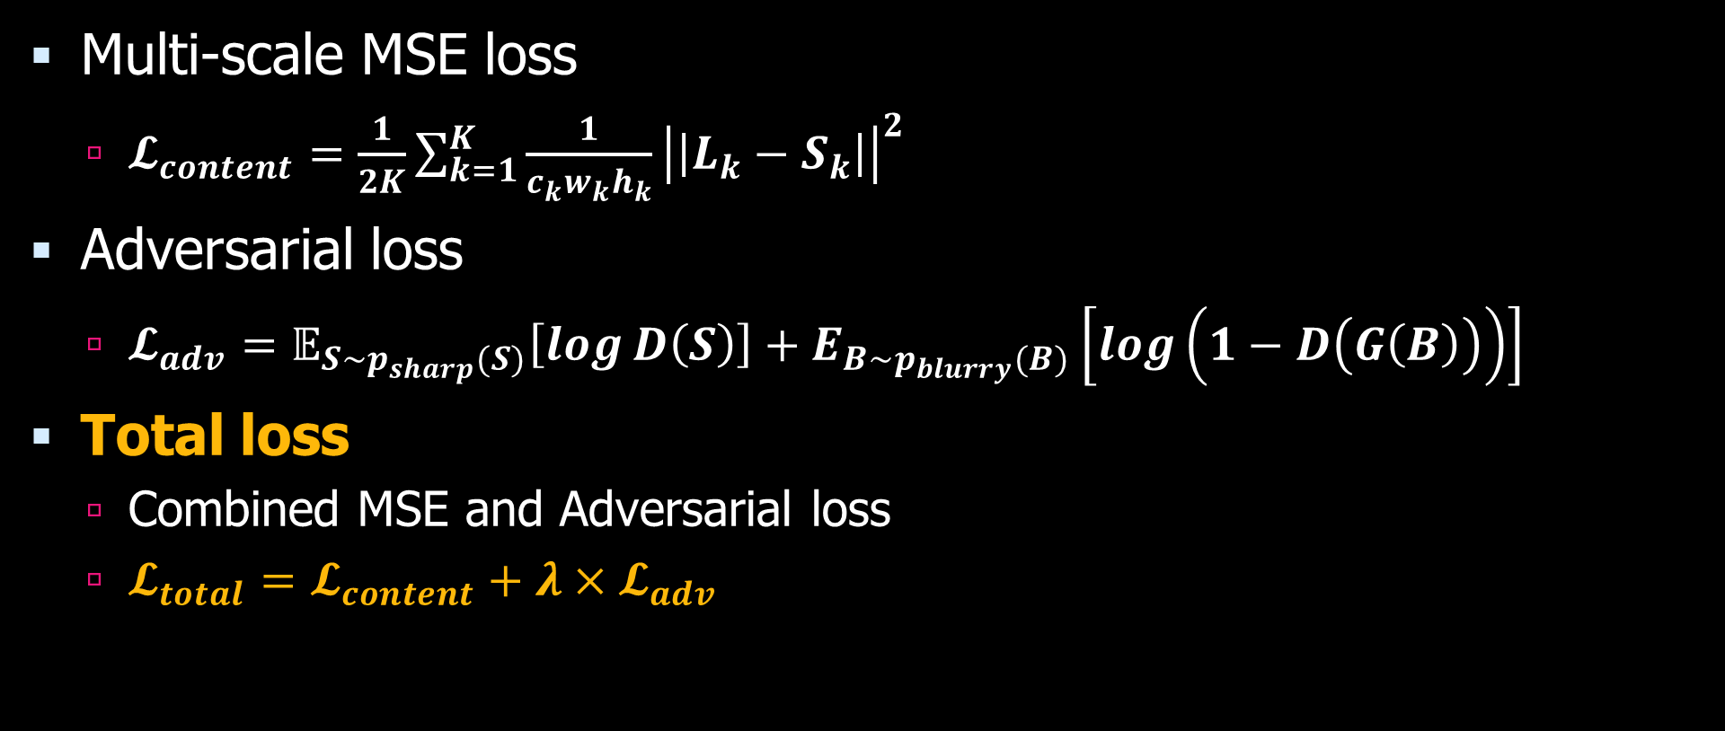
Loss
Multi-scale MSE loss
$𝓛_{content}=\frac{1}{2K}\sum_{k=1}^{K}{\frac{1}{c_{k}w_{k}h_{k}}{\left|\left|L_{k}−S_{k}\right|\right|}^{2}}$
Adversarial loss
$𝓛_{adv}=𝔼_{S\sim p_{sharp}(S)}\left[\log{D\left(S\right)}\right]+E_{B\sim p_{blurry}(B)}\left[\log\left(1−D\left(G\left(B\right)\right)\right)\right]$
Total loss
Combined MSE and Adversarial loss
$𝓛_{total}=𝓛_{content}+λ×𝓛_{adv}$
Notes:
In training our model, we proposed multi-scale content loss, that is MSE loss for each scale.
We also used adversarial loss at the fine scale.
In total, we used the weighted sum of MSE and adversarial loss.
(17s)

Slide 9
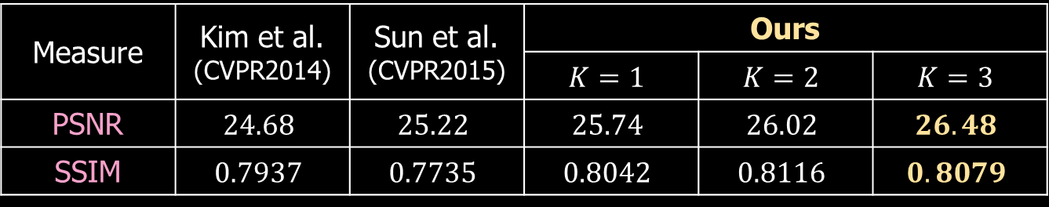

Experimental Results
Quantitative Results
GoPro test dataset (1111 images)
Measure | Kim et al. (CVPR2014) | Sun et al. (CVPR2015) | Ours
 |  |  | $$K=1$$ | $$K=2$$ | $$K=3$$
PSNR | $$23.64$$ | $$24.64$$ | $$28.93$$ | $$29.23$$ | $$29.08$$
SSIM | $$0.8239$$ | $$0.8429$$ | $$0.9100$$ | $$0.9162$$ | $$0.9135$$
Köhler dataset (48 images)
Measure | Kim et al. (CVPR2014) | Sun et al. (CVPR2015) | Ours
 |  |  | $$K=1$$ | $$K=2$$ | $$K=3$$
PSNR | $$24.68$$ | $$25.22$$ | $$25.74$$ | $$26.02$$ | $$26.48$$
SSIM | $$0.7937$$ | $$0.7735$$ | $$0.8042$$ | $$0.8116$$ | $$0.8079$$
Notes:
Here are the experimental results.
For quantitative comparison, we evaluated deblurring performance on our propsed dataset and Köhler dataset.
Our results show large improvements over previous methods.
(15s)

Slide 10
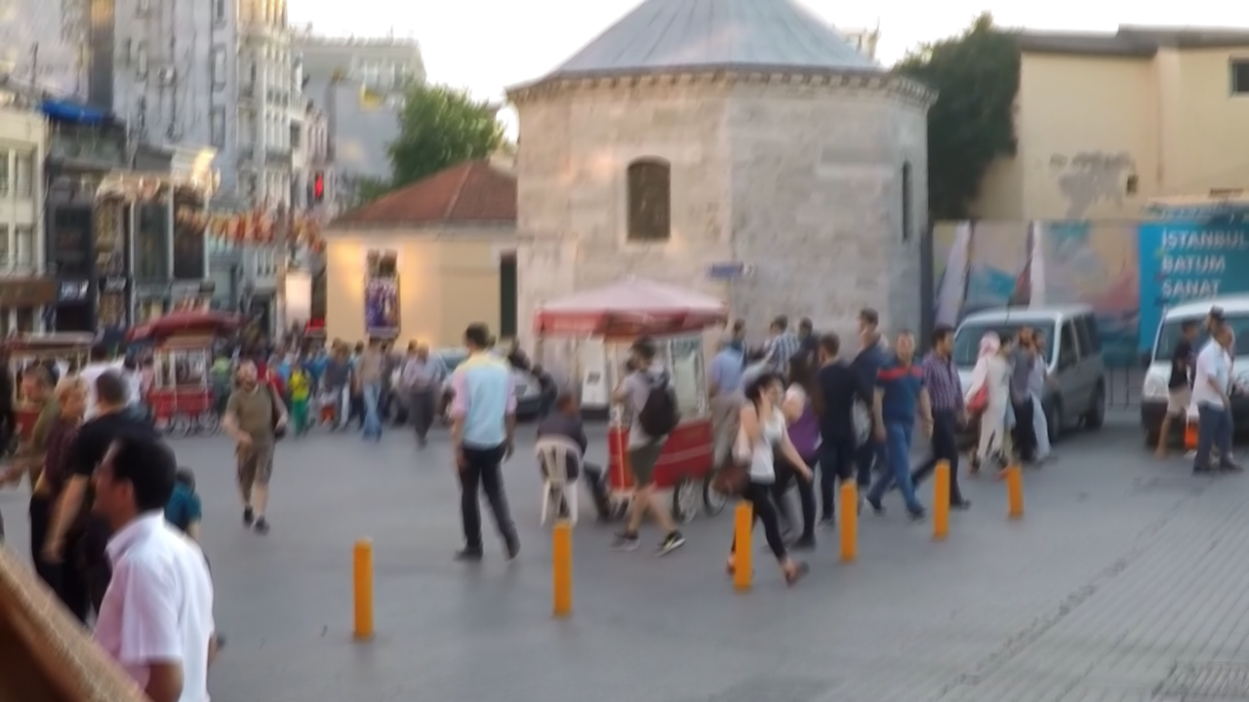


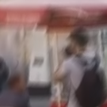
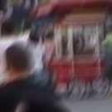
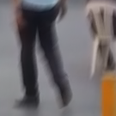


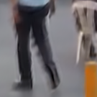
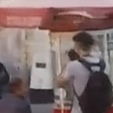
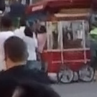
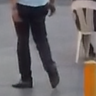
Experimental Results
Qualitative Results
Blurry input
Sun et al. (CVPR2015)
Ours
Notes:
This is a qualitative comparison.
Take a look at the colored boxes.
Our method can remove complex blurs and recover sharp details.
(12s)

Slide 11
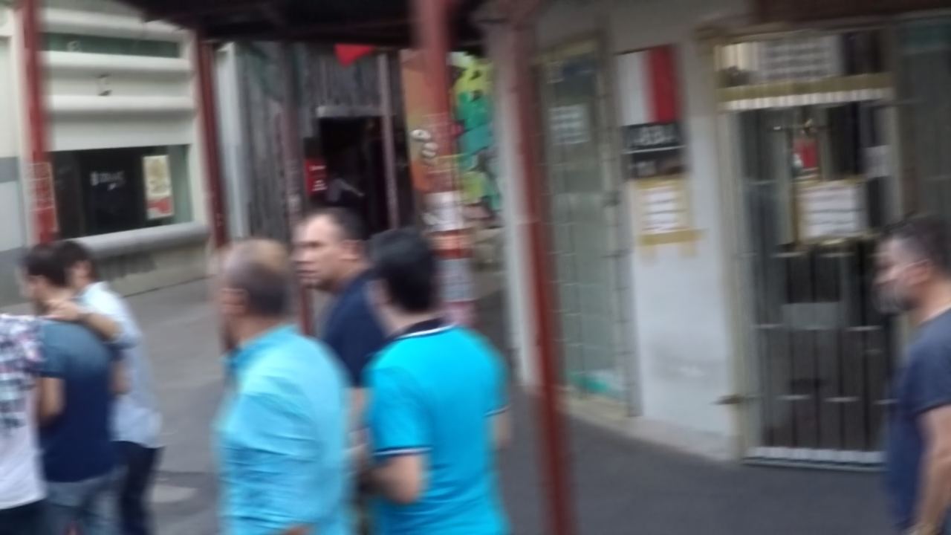



Blurry input
Kim and Lee (CVPR2014)
Sun et al. (CVPR2015)
Ours
Notes:
More experimental results follow.
The face of moving person, letters on the wall, and the thin bars are recovered by our method while other methods fail.
(12s)

Slide 12
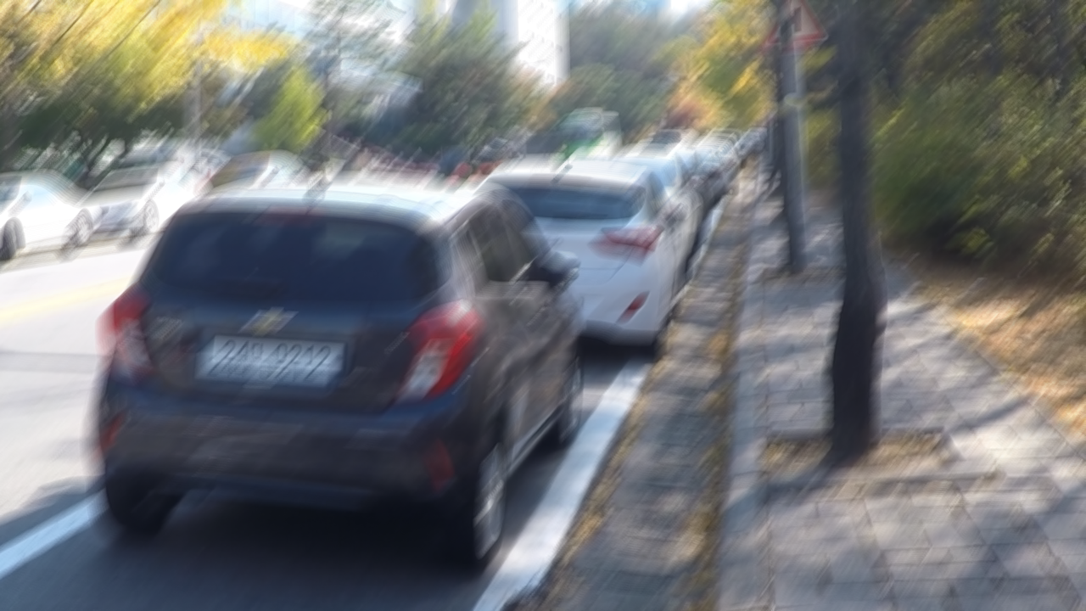



Blurry input
Kim and Lee (CVPR2014)
Sun et al. (CVPR2015)
Ours
Notes:
You can see the car plate numbers are readable in our result.
(12s)

Slide 13
Conclusion
A new blur image dataset with ground truth
Multi-scale CNN architecture resembling coarse-to-fine approach
End-to-end direct image deblurring without kernel estimation
Superior performance compared to other methods
Notes:
Let me conclude.
In this research, we proposed a new blur image dataset with ground truth.
We proposed a multi-scale CNN architecture in line with coarse-to-fine approach.
We directly estimated images without kernel estimation.
Finally, our results exhibit superior performance.
(20s)

Slide 14
Thank you
http://cv.snu.ac.kr
Notes:
Thank you.

